Slide 1
NEW TOPIC
Algebra

Slide 2
Contents
Glossary or Formula Page
Page
Date
Description
Word
Description
2
3

Slide 3
Tasks
24
7
30
Topic
Essential Question
Questions
Notes
Summary
8
9

Slide 4
Pattern’s and Rules
Miss L
Year 7

Slide 5
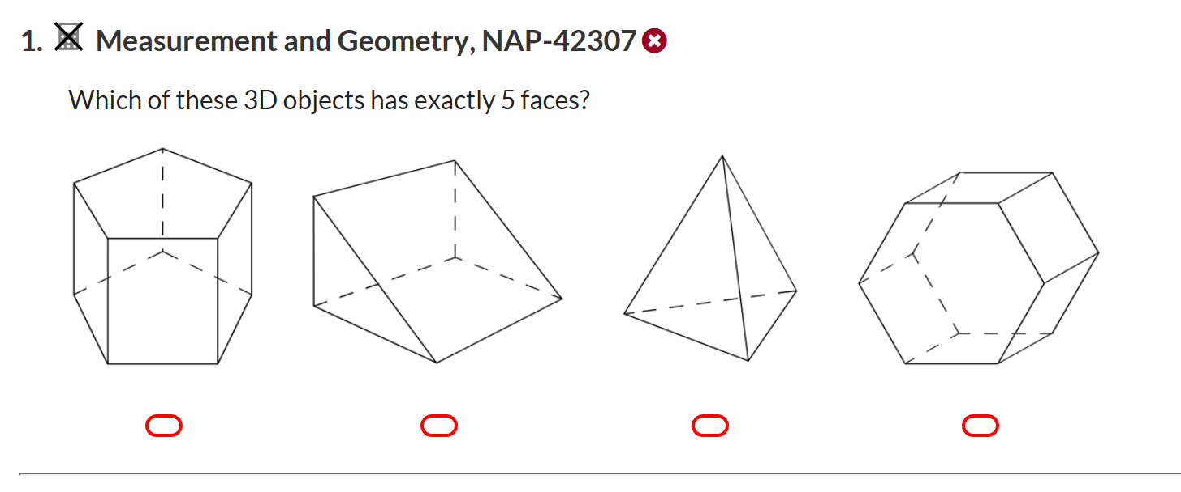

Slide 6
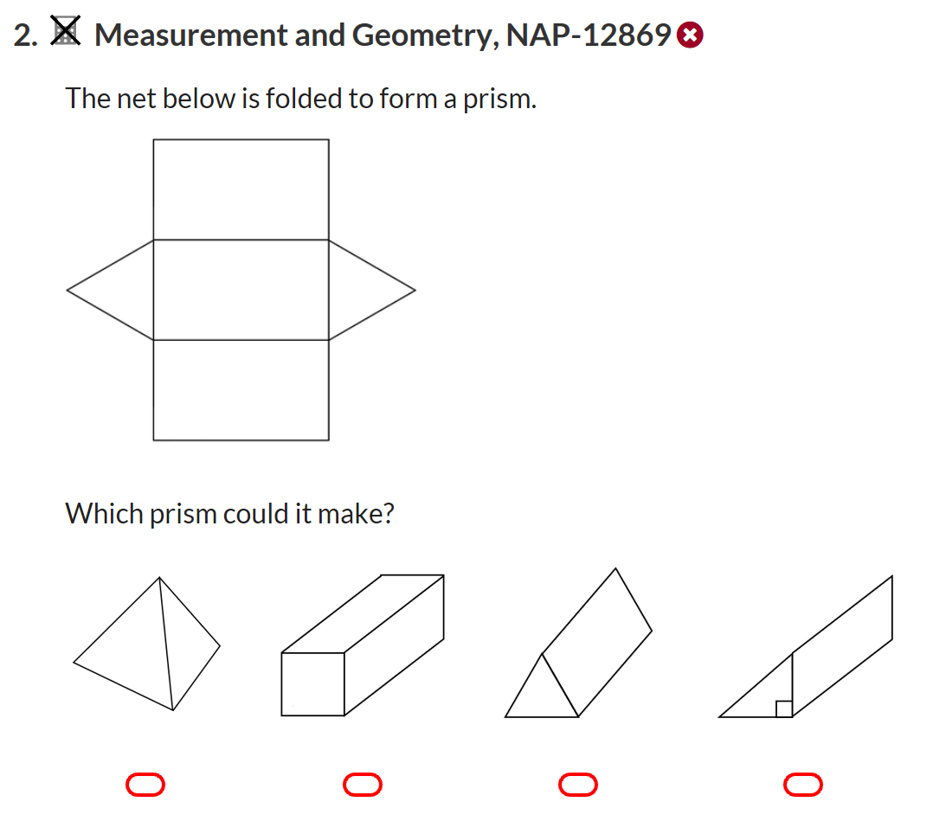

Slide 7
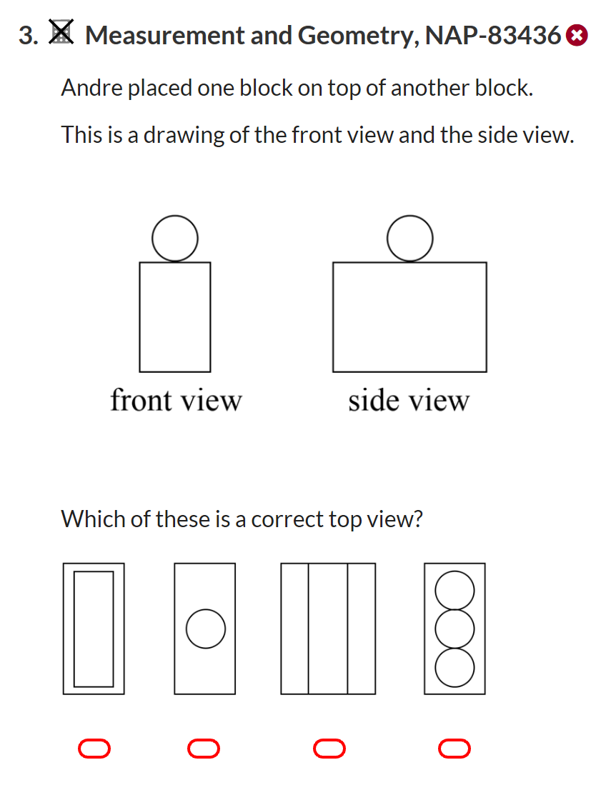

Slide 8
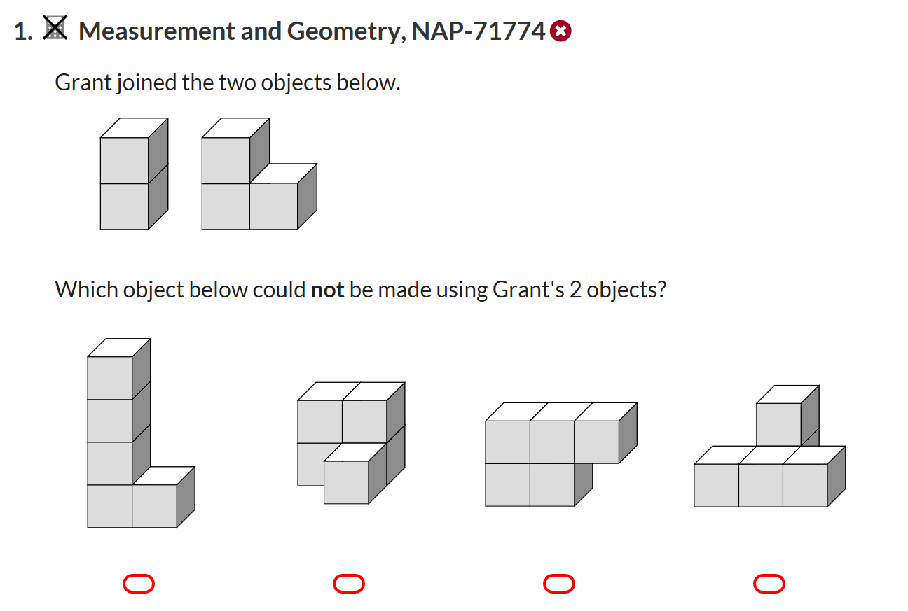

Slide 9
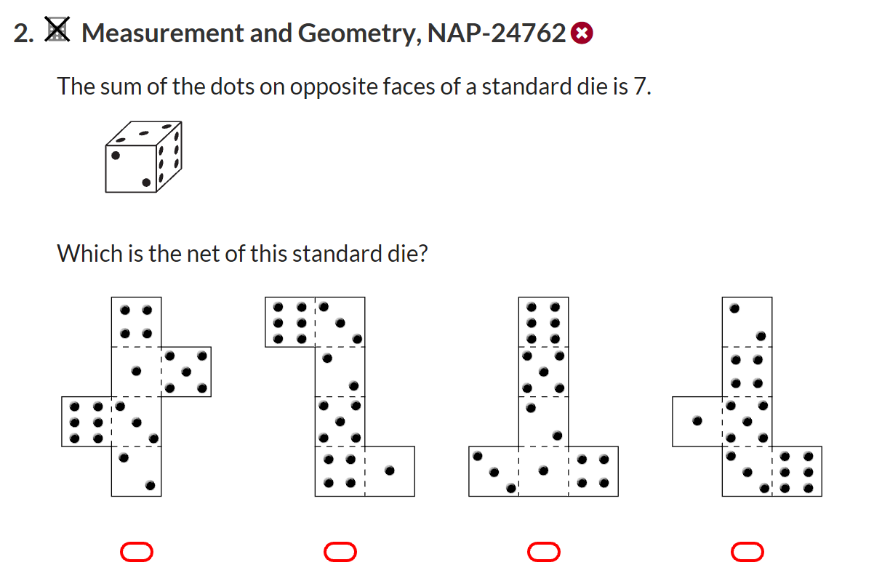

Slide 10
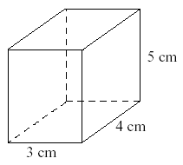
From Last Lesson
Find the volume of the following:

Slide 11
What is this special pattern called?
0, 1, 1, 2, 3, 5, 8, 13, 21, 34
The Fibonacci Sequence
The rule: x_{n} = x_{n-1} + x_{n-2}.

Slide 12
24
7
30
Algebra: Pattern’s and Rules
Date
EQ – How to find a rule from a number pattern?
Using rules
Math can be used to describe relationships in the word around us.
Sequence
Term
Rule
A number pattern can be called a sequence
Each number in the sequence is called a term
A sequence has a rule that describes the pattern
0, 1, 1, 2, 3, 5, 8, 13, 21, 34
The rule: x_{n} = x_{n-1} + x_{n-2}.

Slide 13
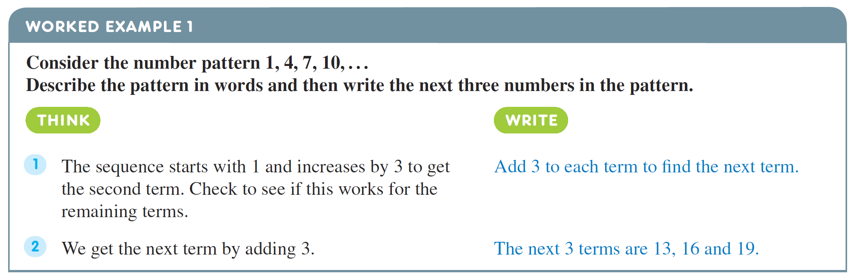
24
7
30
Algebra: Pattern’s and Rules
Date
EQ – How to find a rule from a number pattern?

Slide 14
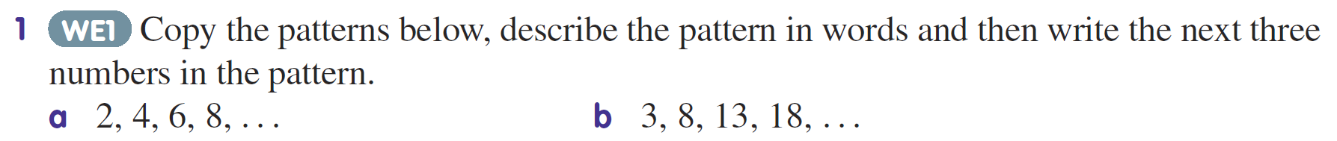
Practice

Slide 15


Slide 16
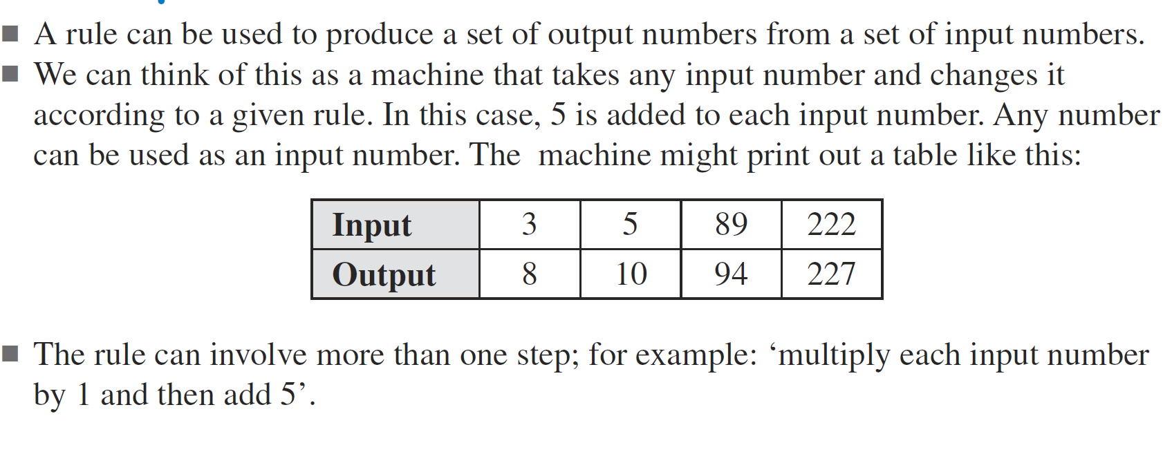
24
7
30
Algebra: Pattern’s and Rules
Date
EQ – How to find a rule from a number pattern?
Input and Output Tables

Slide 17
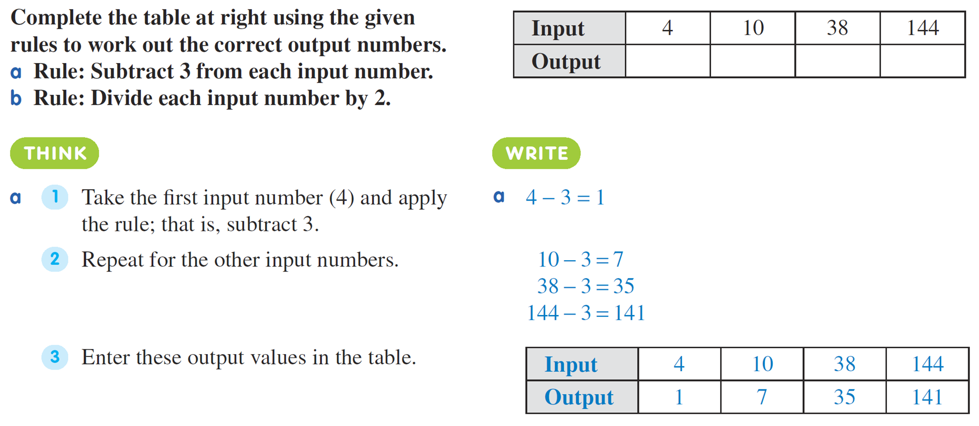
24
7
30
Algebra: Pattern’s and Rules
Date
EQ – How to find a rule from a number pattern?

Slide 18
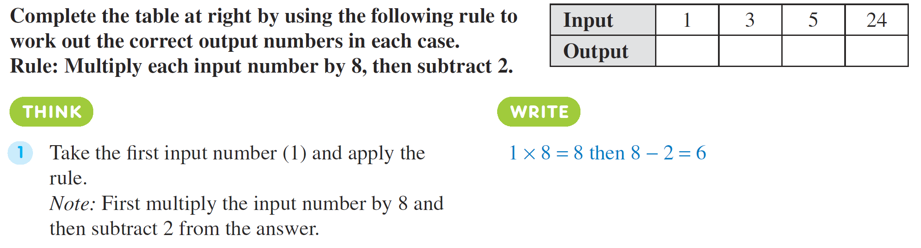
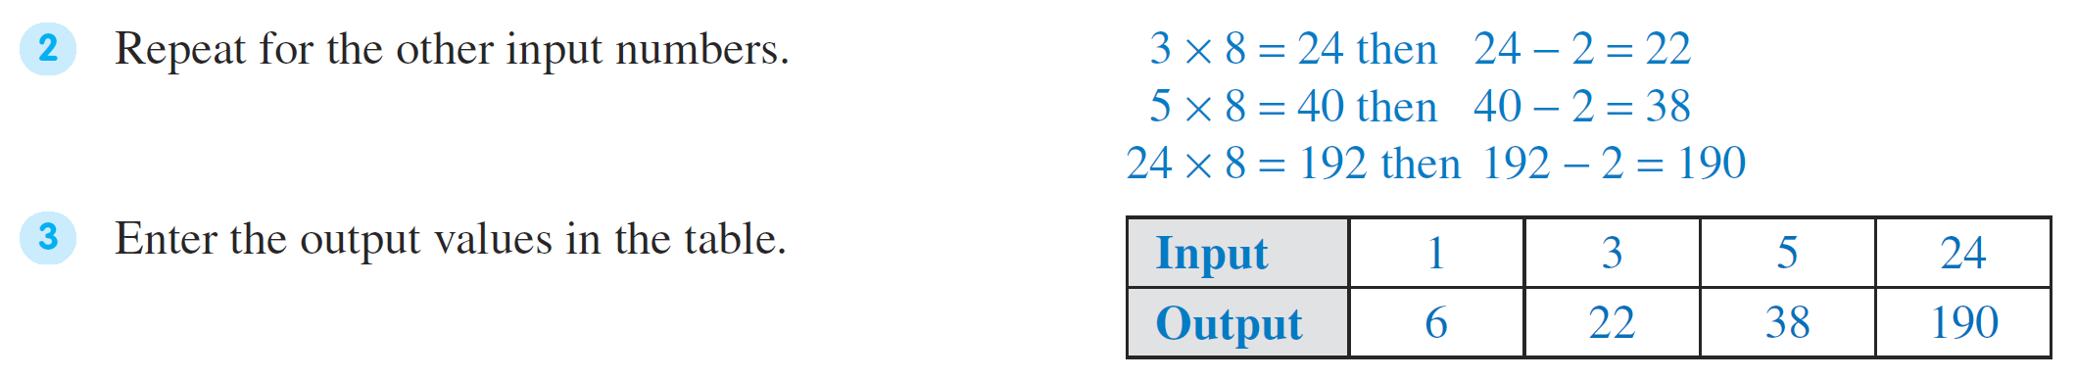

Slide 19
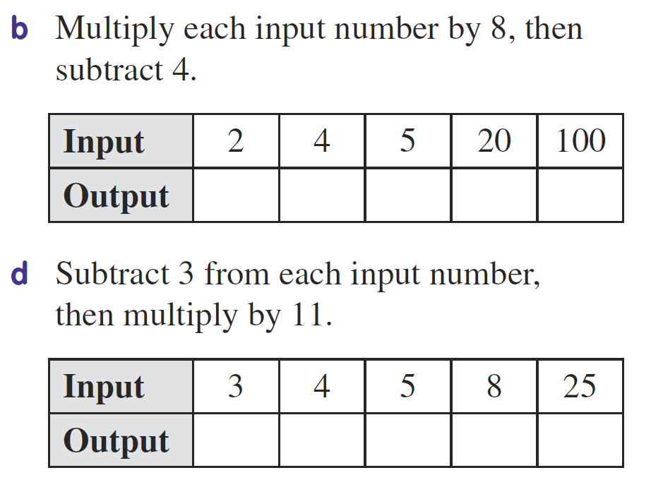
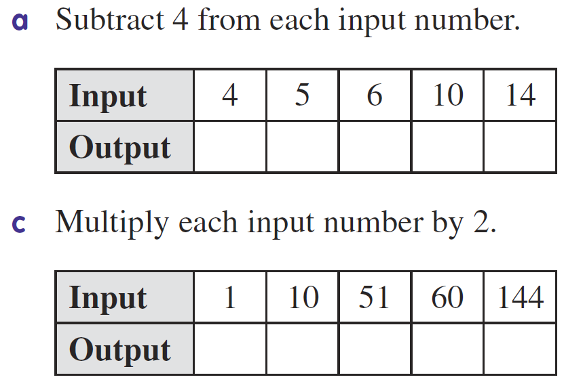
Task
Complete Summary and Exit Pass once done

